Slide 1



Azure Function for Google Home Actions

Slide 2

About Me
Vladislav Nedosekin
Cloud Evangelist with over 15 years of experience and an infectious enthusiasm for technology
LinkedIn: https://www.linkedin.com/in/vladislavnedosekin/
Twitter: https://twitter.com/nedosekinvlad
GitHub: https://github.com/mrvladis

Slide 3

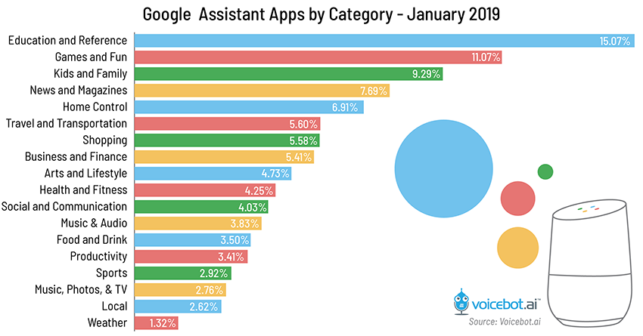
Google Home
Notes:
While “Travel and Transportation” Actions listed on the 6th place – I didn’t manage to find a way to check the departure board on the station.
It was possible to ask Google Home about the Bus departure from the bus stop, or how get somewhere, but it was not exactly what I was only giving me information about one train.
Weather is just 1.32%, but you can ask google home about the weather, but not about trains on your train station.

Slide 4




Formula
Notes:
Having 2 weeks between the jobs, I got slightly bored and thought that I need to do something to solve my challenge with the trains.
Being lazy person that loves PowerShell and has MSDN benefit - I clearly decided that Azure Functions with PowerShell would be a part of the solution that I am going to explore.

Slide 5
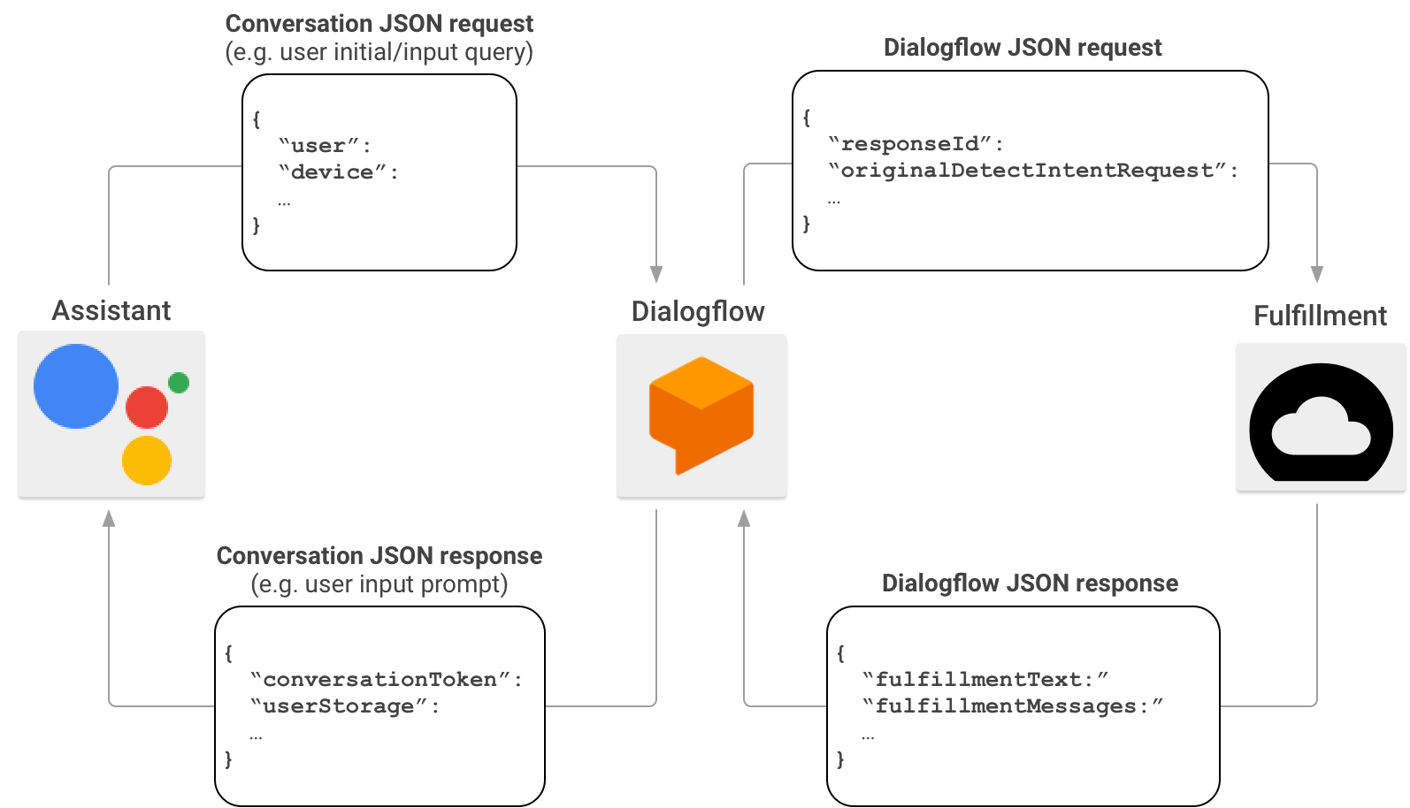
Google Action
Dialogflow is an optional component
Dialogflow acts as a proxy between Actions on Google and your fulfilment
All communications API driven with JSON as a payload
Notes:
Conversation requests and responses
In a typical Actions on Google interaction scenario, users utter a phrase to invoke an Action. To provide a response, Actions on Google finds the fulfillment that matches the Action invoked by the user and sends the request there.
Once Actions on Google establishes that your fulfillment is a suitable match for the user's invocation, it starts a conversation session by sending an HTTP request that contains a JSON payload with the user's request information to your fulfillment endpoint. Your fulfillment parses the request and returns a response that contains a JSON payload. Actions on Google then converts the payload into rendered speech and multimedia output for users.
Dialogflow requests and responses
If you are creating Actions, you can optionally use Dialogflow to simplify the task of building conversational interfaces. In this scenario, Dialogflow acts as a proxy between Actions on Google and your fulfillment. Instead of sending the HTTP/JSON request directly to your fulfillment endpoint, Actions on Google sends it to Dialogflow.
Dialogflow wraps the JSON payload contained in the original request into the Dialogflow webhook format, and forwards the resulting request to your fulfillment.
Conversely, when your fulfillment sends a response to Dialogflow, the JSON payload of the response must comply with the Dialogflow webhook format. Your fulfillment parses the parameters from the Dialogflow JSON request, and generates a response in the Dialogflow webhook format. Dialogflow then converts the response from your fulfillment into a response message that the Assistant understands.

Slide 6
Solution Overview

Slide 7
Solution Integration
Process request from Google Assistant (Dialogflow)
Request data from the National Rail
Process data from Nation Rail
Reply to Google Assistant (Dialogflow)

Slide 8
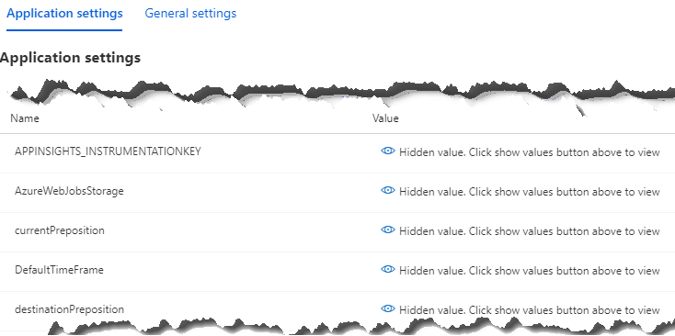
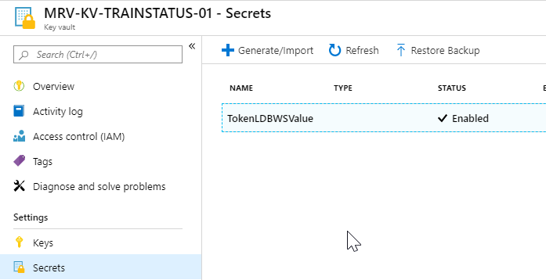
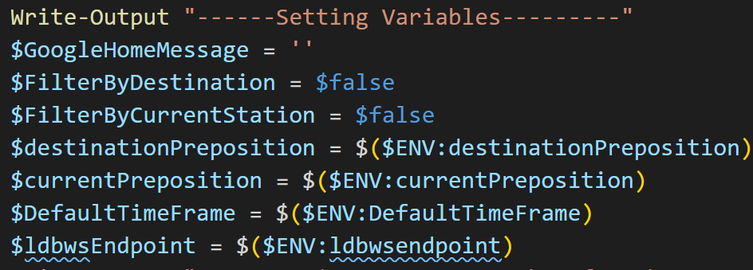
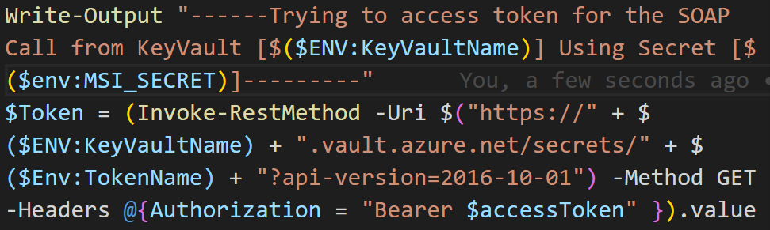
Variables
Simple Variables (Application Settings) | Secrets (Azure KeyVault)

Slide 9
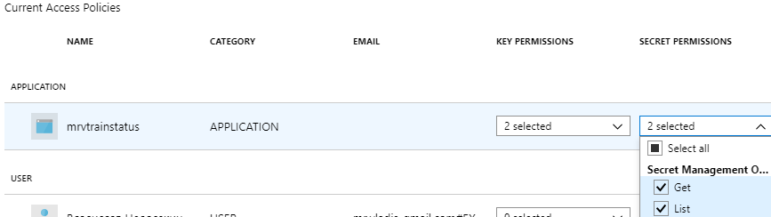
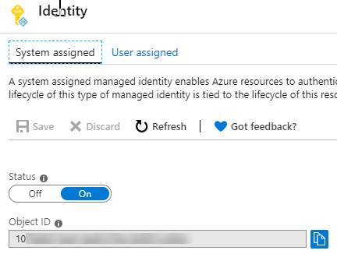
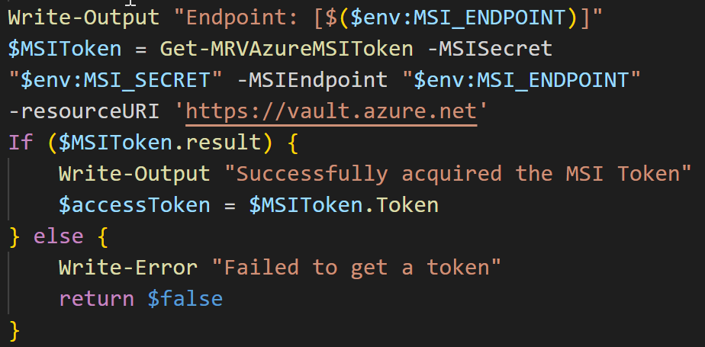
Managed Service Identity

Slide 10
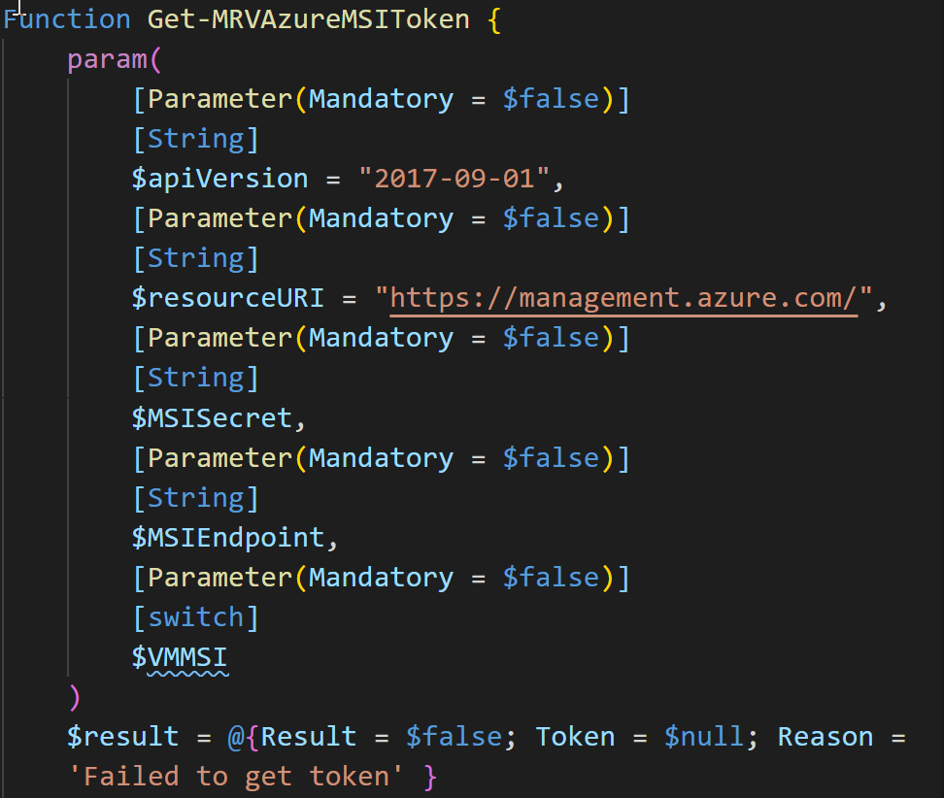
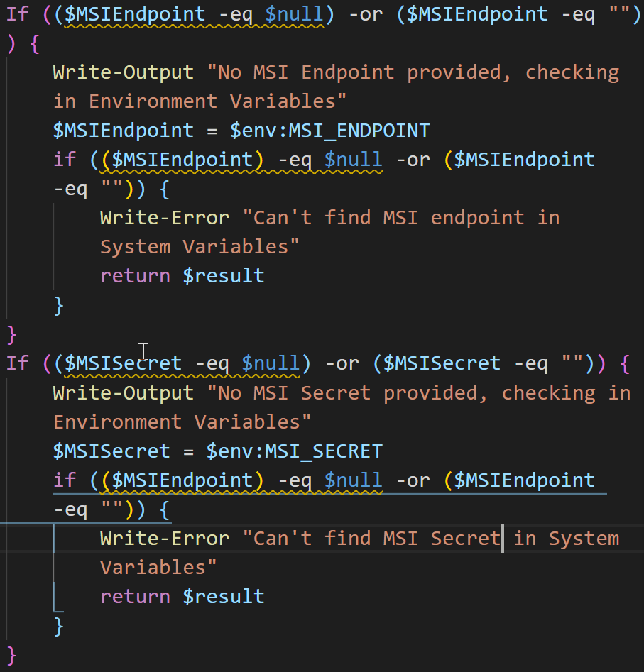
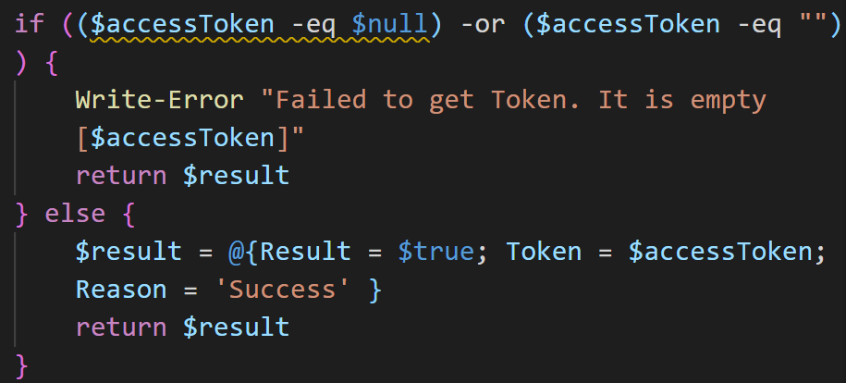
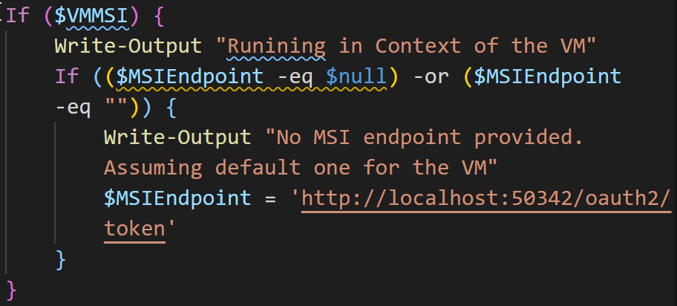
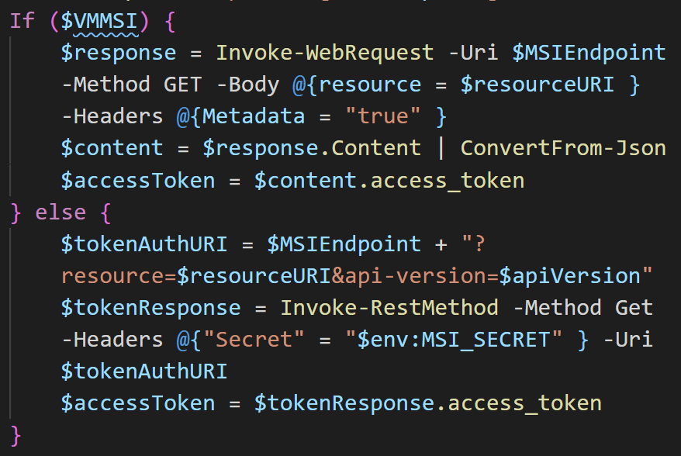
MSI Token

Slide 11
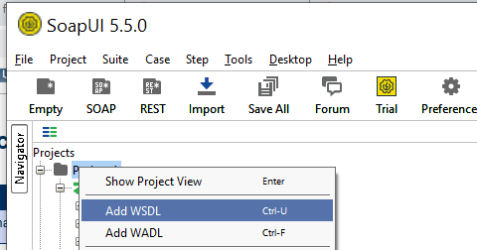
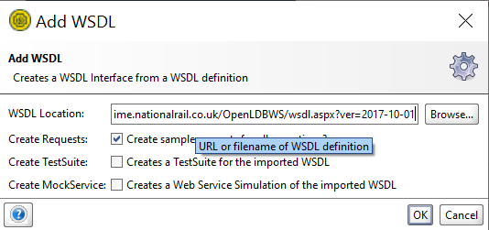
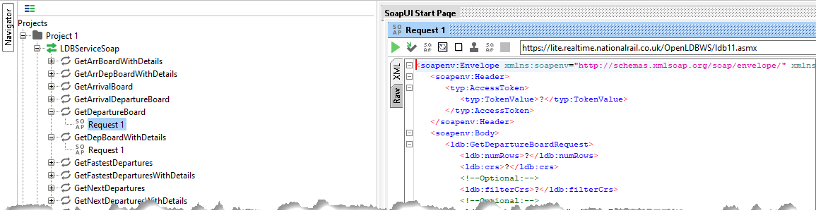
Exploring Data Source (SOAP)

Slide 12
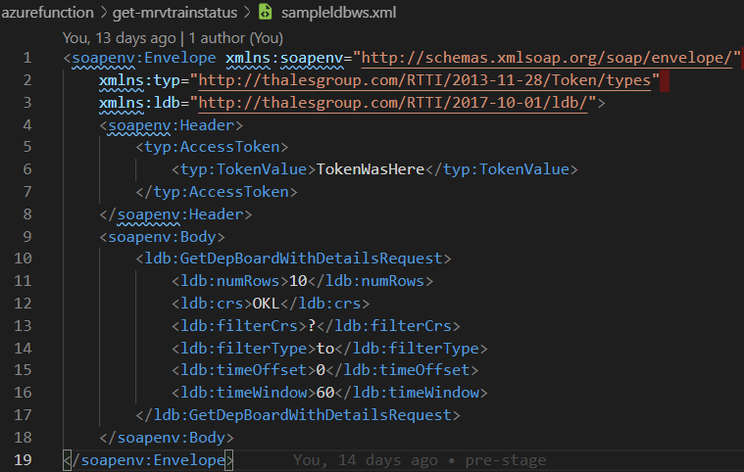
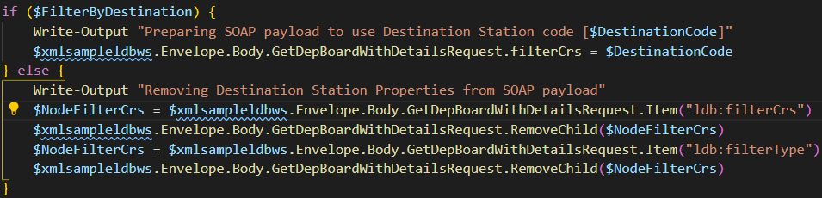
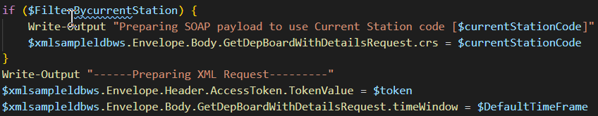
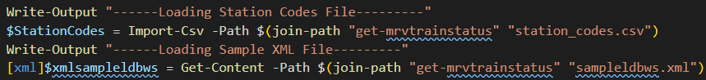
Request Payload
Notes:
We populate the

Slide 13
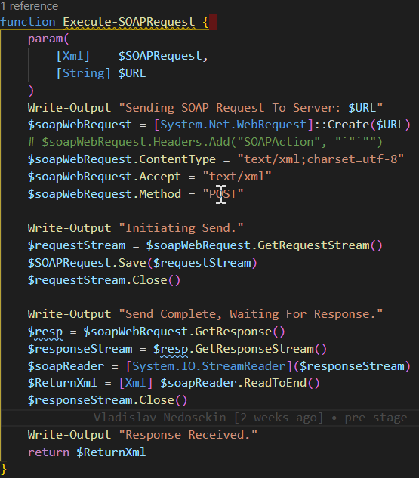
Request Data

Slide 14
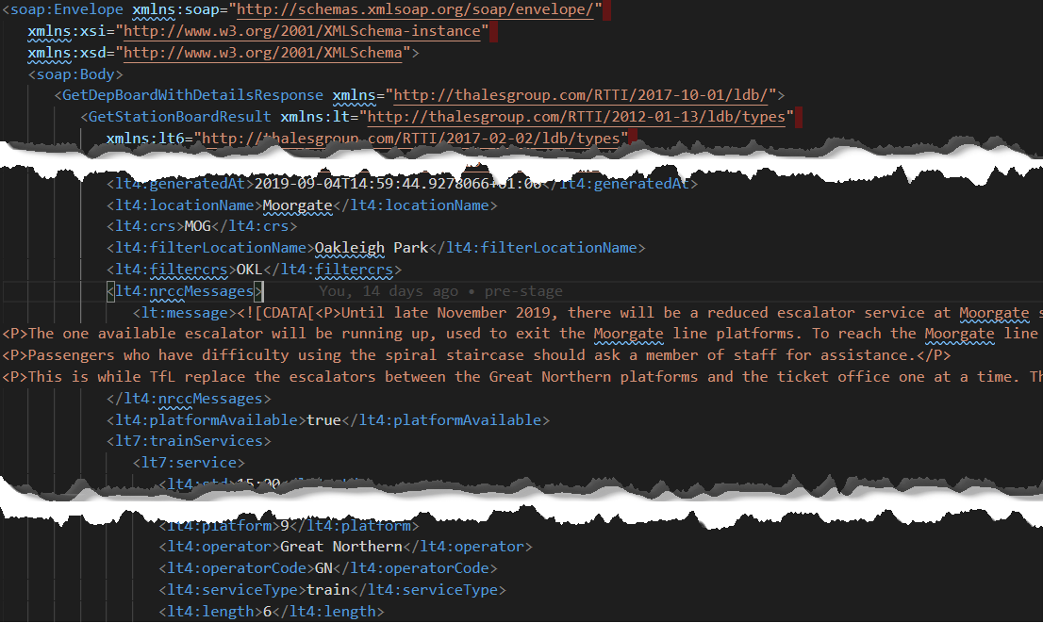
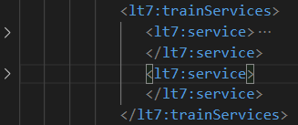
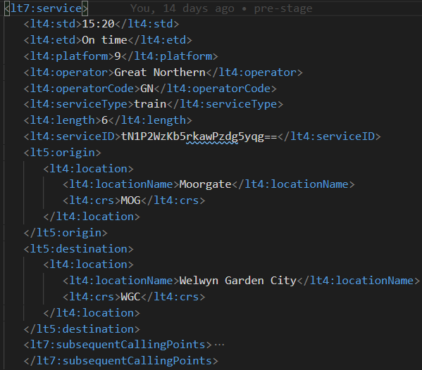
Process Received Data

Slide 15
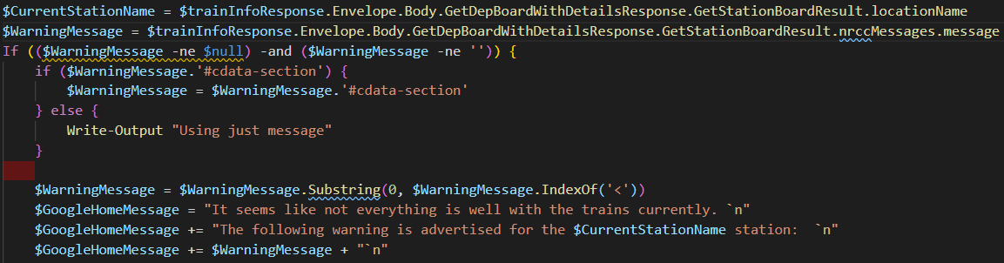
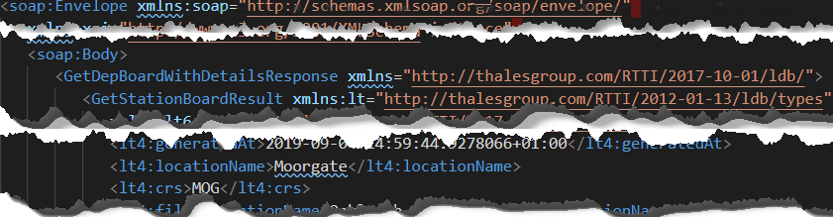
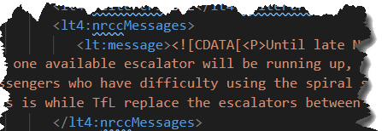
Process Received Data

Slide 16
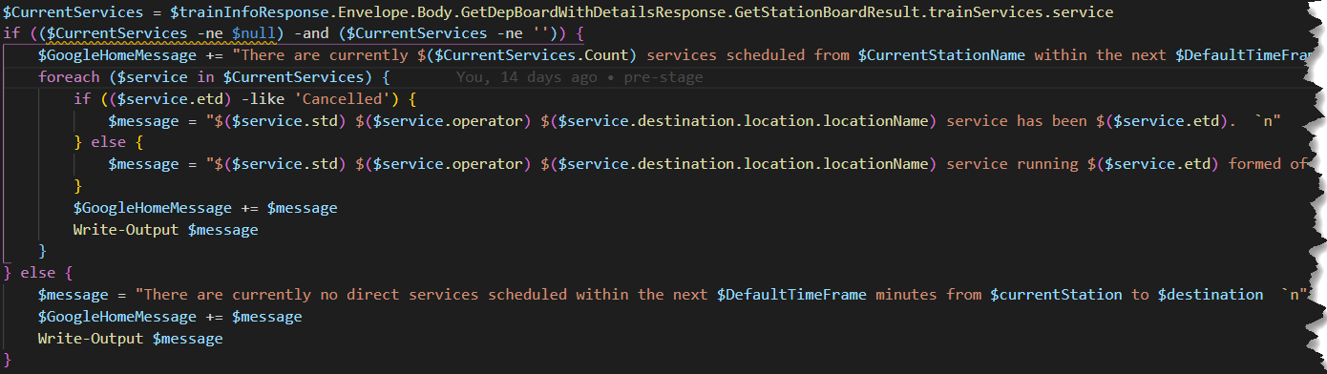
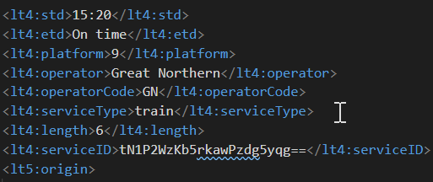
Process Received Data

Slide 17
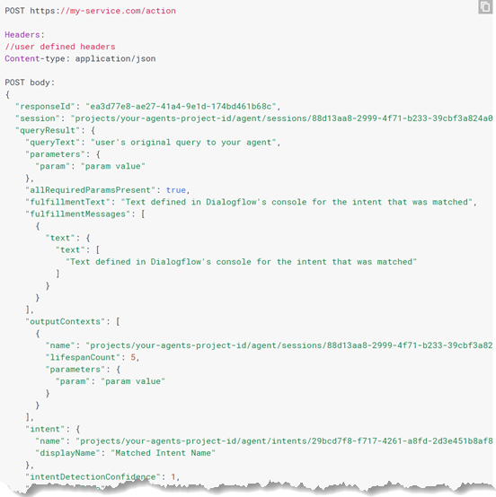
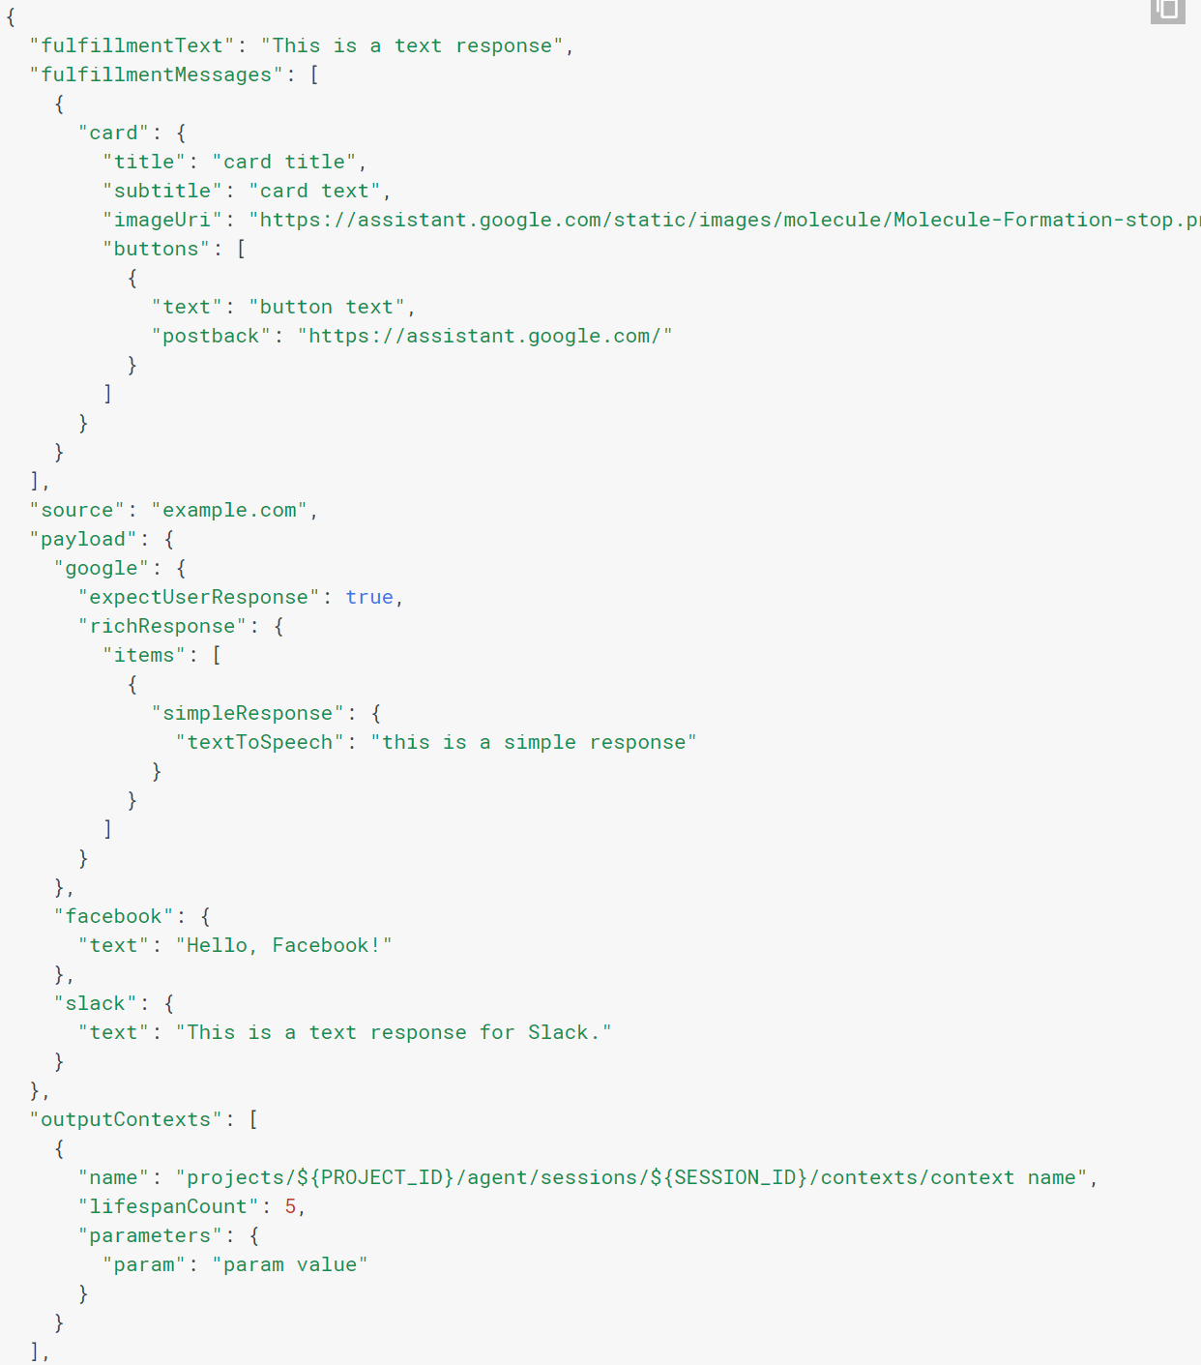
Google Payload

Slide 18
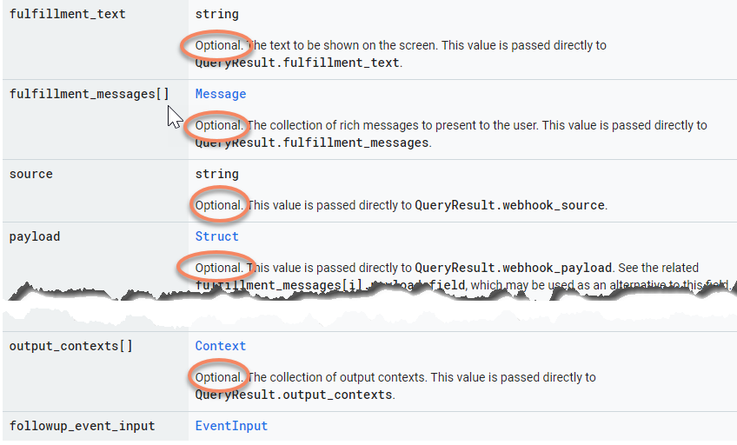
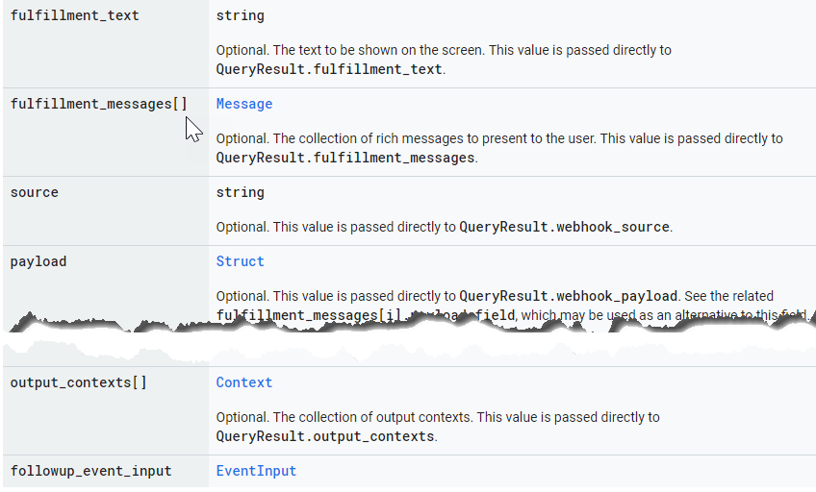
Why we need to read documentation

Slide 19
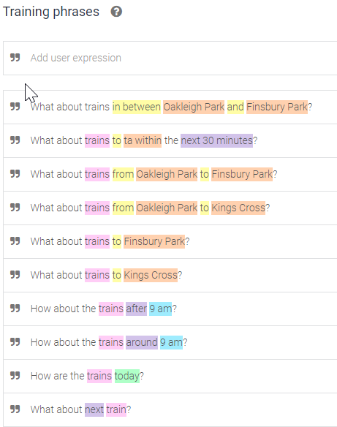
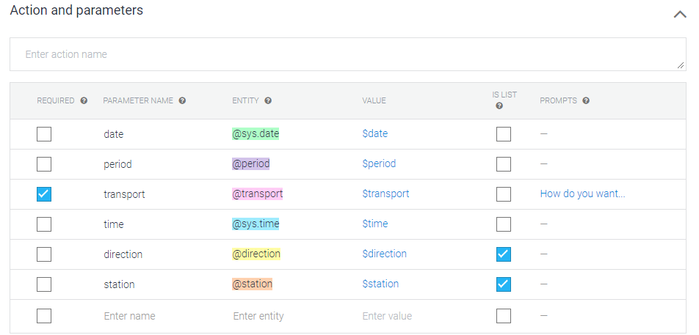
Intents

Slide 20
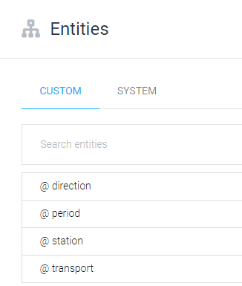
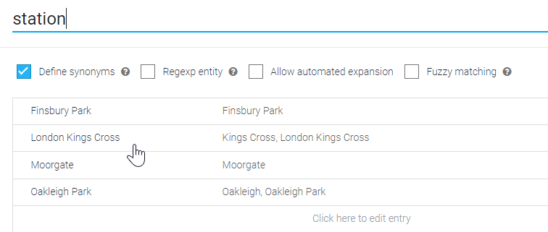
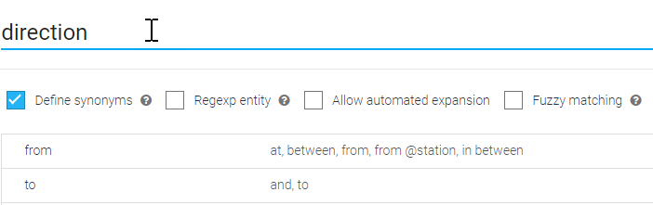
ENTITIES

Slide 21
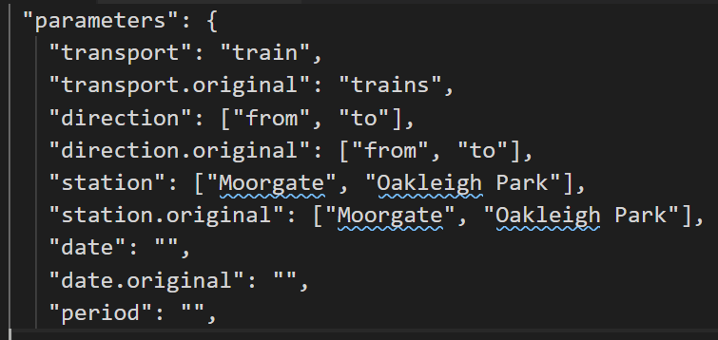
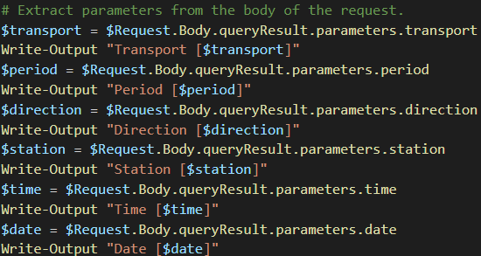
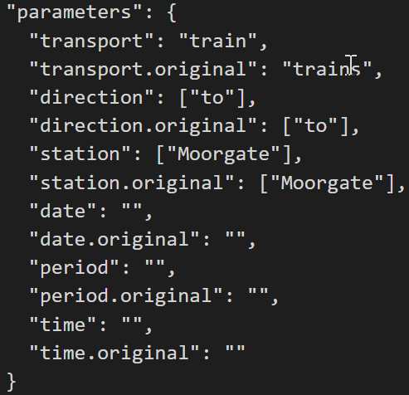
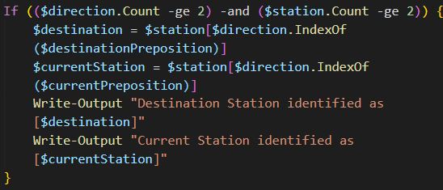
Google Request Data
Notes:
Current logic require to provide both source and destination. If only one provided – it will fall back to the default request.

Slide 22
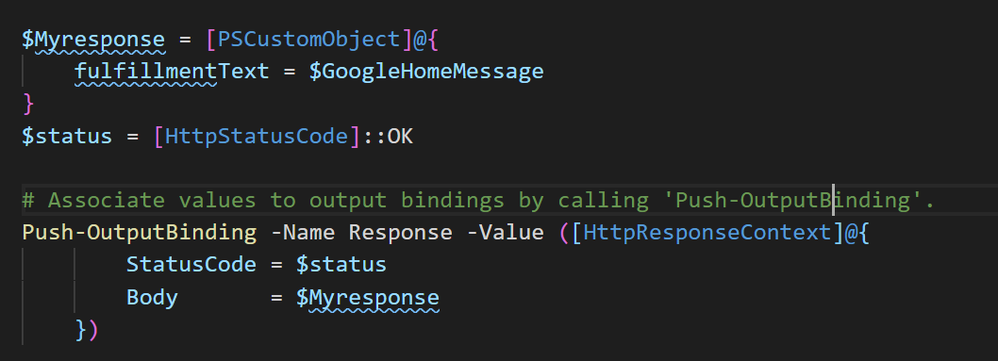
Google Response

Slide 23
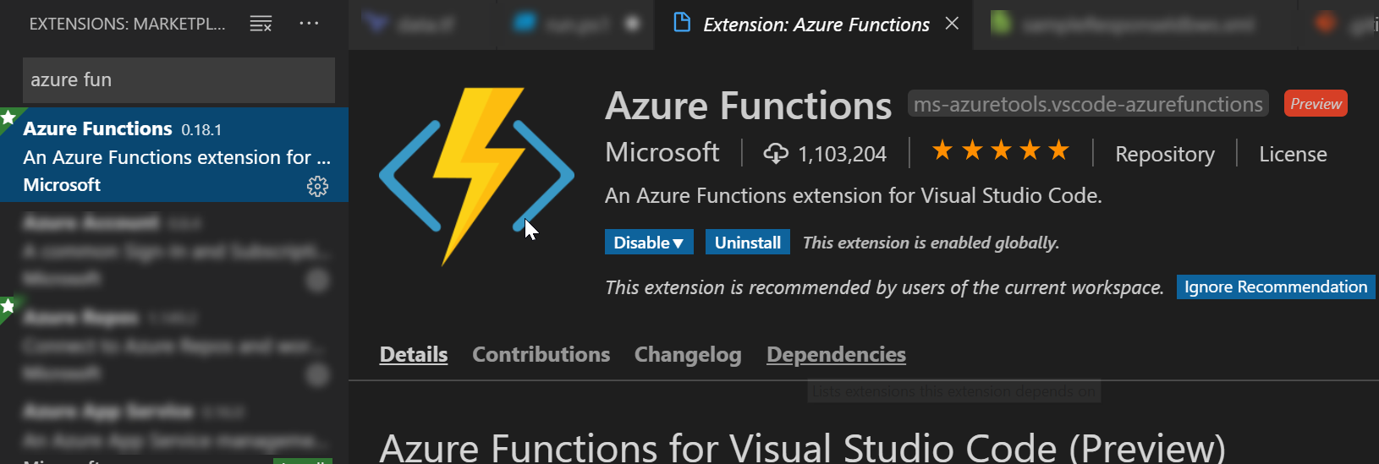
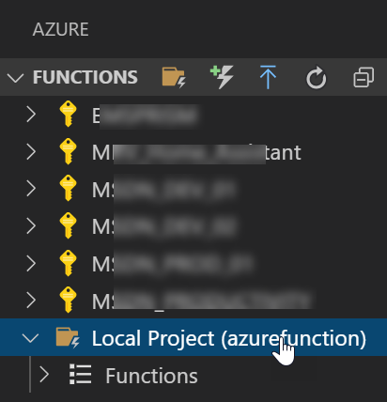
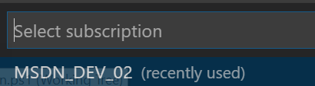
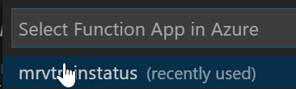
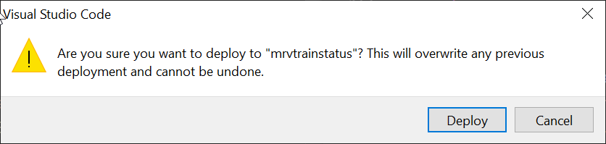
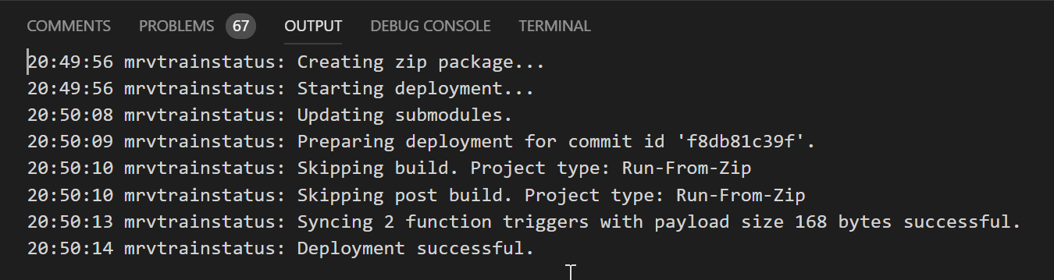
Deploy

Slide 24



Logging

Slide 25


Logging In VSCODE

Slide 26



Module

Slide 27

DEMO

Slide 28
To Do
Entities Converter
PowerShell Module
Advanced Logic
Unit Tests
CI / CD Pipeline
Notes:
Entities Converter - So they can be populated from the station list.
PowerShell Module
Advanced Logic
Unit Tests
CI / CD Pipeline

Slide 29
Sources
https://github.com/mrvladis/trainsforgooglehome
https://lite.realtime.nationalrail.co.uk/OpenLDBWS/
https://docs.microsoft.com/en-us/azure/azure-functions/functions-create-first-function-powershell
https://docs.microsoft.com/en-us/azure/azure-functions/functions-reference-powershell
https://console.actions.google.com/u/0/
https://ponderingthought.com/2010/01/17/execute-a-soap-request-from-powershell/

Slide 30


